Slide 1
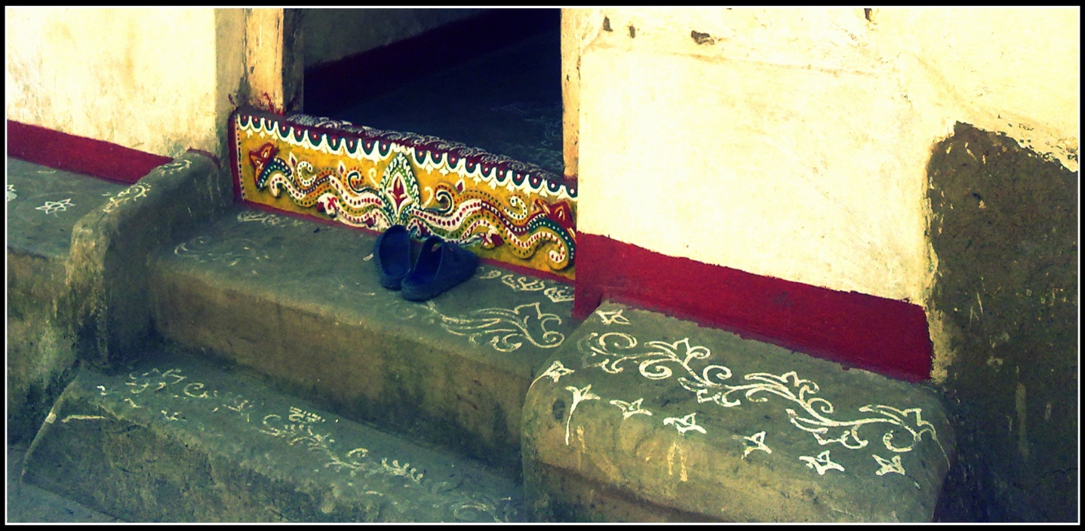
Public Policy Analysis National Policy on Tribals
Dr. MCRHRDIAP 87th FOUNDATION COURSE

Slide 2
Group Number 15: Members
Sri Tulsi Das
Ms. Akansha Aggarwal
Sri Deepak Ranjan
Sri Somendu Kumar Dash
Sri Abhishek Yadav
Sri Gudimella Pawan Kumar
Sri Vikram Tanwar
Sri Shravan Ram
Sri Prabhat Bhaskar
Sri Anil Patel

Slide 3
India’s Tribal Heritage
698 scheduled Tribes
67.8 million Tribal Population
75 as Primitive Tribal groups
Constitutional Protection
Article 342
Nehruvian Panchasheel
8.08% of the Total Population
Ministry of Tribal Affairs
Drafting National policy on Tribals

Slide 4
Why a National Policy?
Problems:
Policy Objectives:
Abject Poverty
Poor Literacy Rates
Malnourishment and Disease
Displacement
Address Low HDI
Mainstreaming
Promoting Tribal Culture and Heritage
Holistic and Participative approach

Slide 5
Key Elements
Formal Education
Employment as teachers
Health
Promoting Agriculture
Extension of ‘Sarva Shiksha Abhiyan’ in tribal areas
Extension of basic Public health facility
Land Ownership

Slide 6
Continued…
Forest Villages
Minimum Amenities and services
Associating Tribals with protection, management and development of forests
Displacement - as a last resort
Resettlement- for better living standards
Land grants and financial assistance
Traditional Wisdom, Culture and Heritage
Documentation and Preservation
Cultural Centres
Recognising their customary rights in the forests
Promotion of Tribal Languages
Intellectual Property Rights
Administrative and Governance Structure
Good Governance
Multi-institutional Delivery System
Participative and Community Oriented

Slide 7
Stakeholders in the policy:
Tribal Community .
Ministry of tribal Affair.
Ministry of Environment and Forest.
Various other Ministries and Departments.
NGOs and Civil Societies.
Media.
Citizens of India

Slide 8
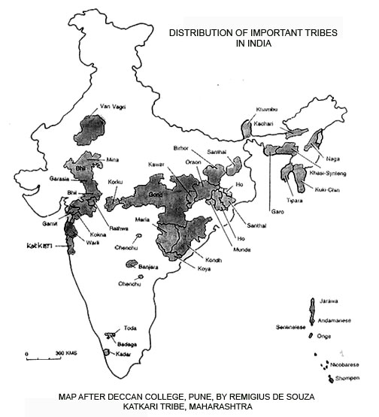
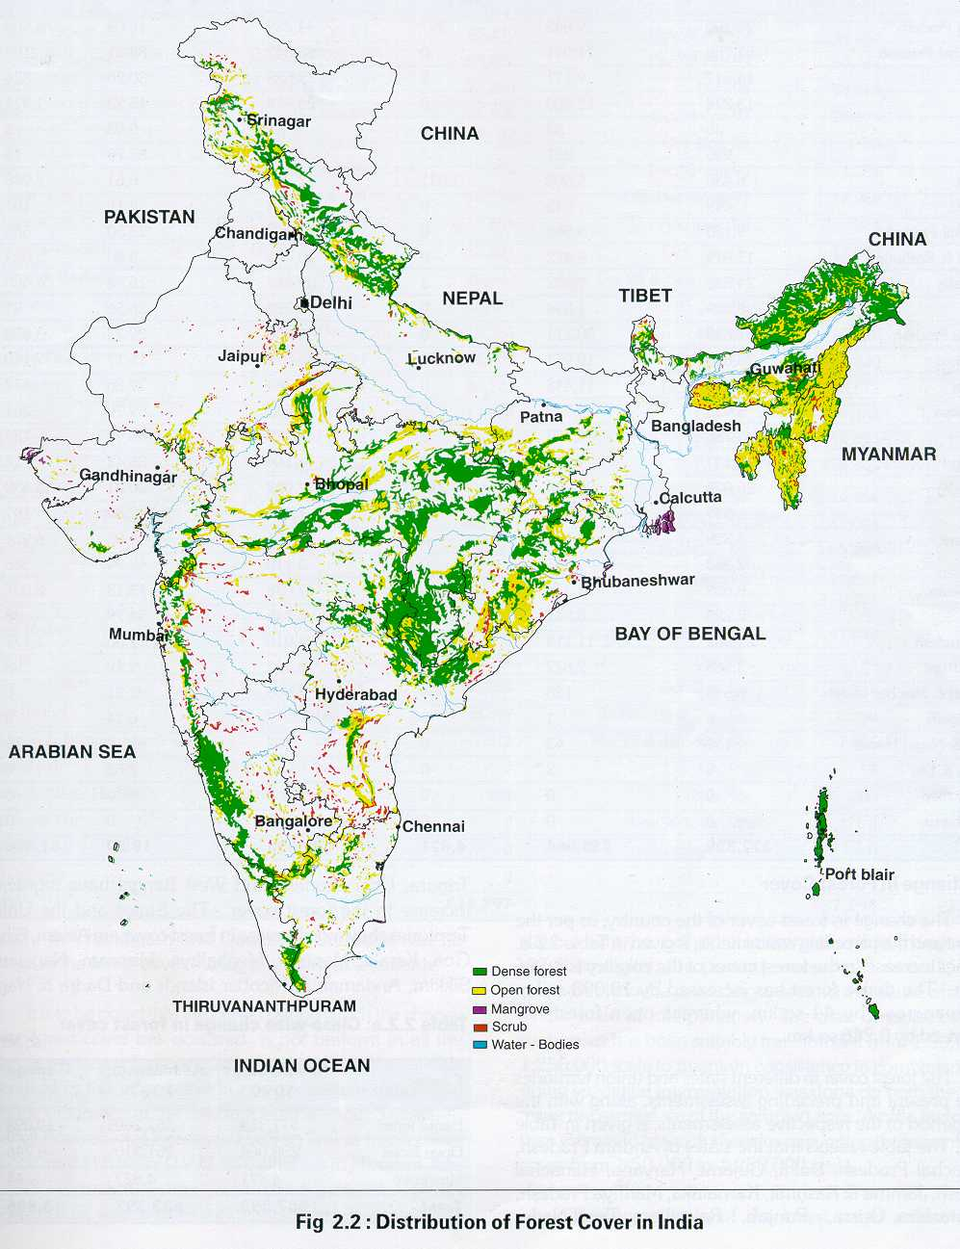
Tribes and Forest

Slide 9
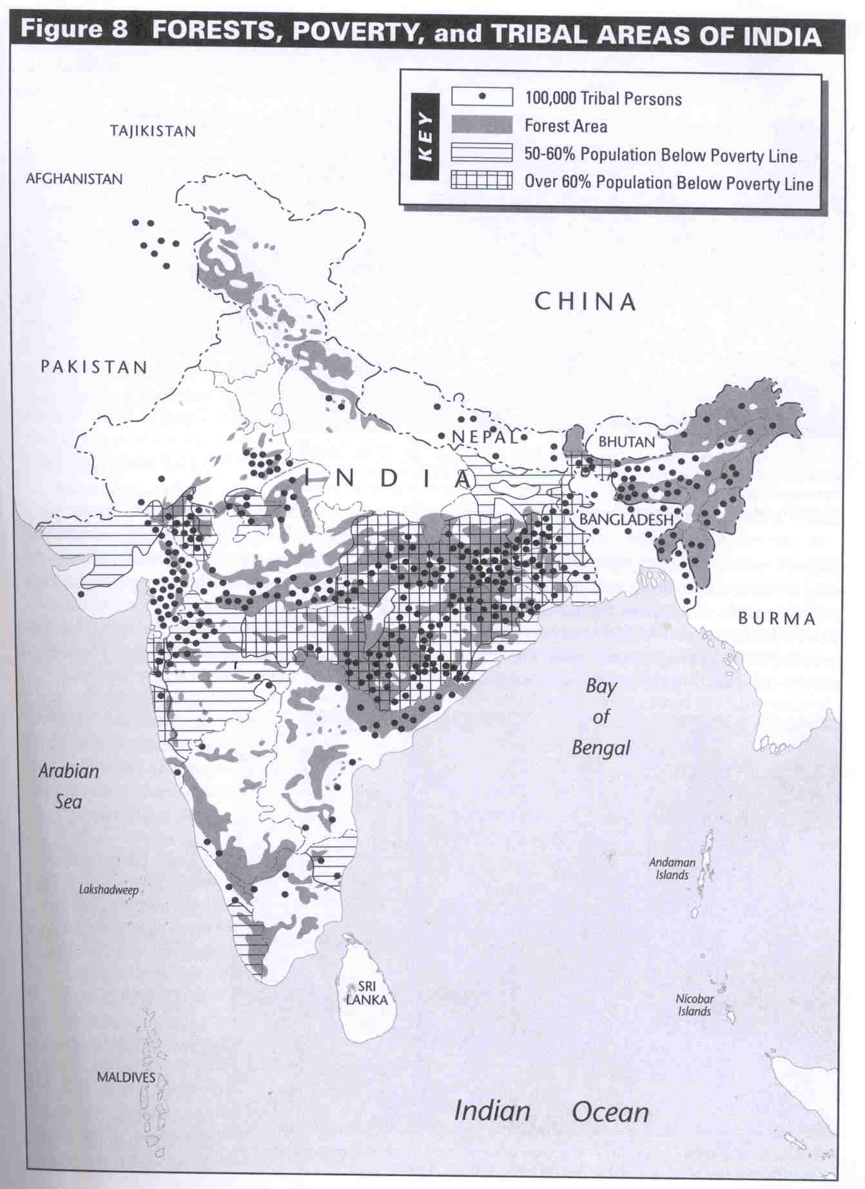

Slide 10
National Forest Policy
In one of the objective- Creating a massive people's movement with the involvement of women, for achieving these objectives and to minimise pressure on existing forests.
Right and concession – people living near the forest area

Slide 11
Tribal People and Forests
Symbiotic relation between forest and tribal
Contractor should be replaced by tribal cooperative, government corporation
Institutional arrangement for NTFP collection
Development of Forest villages
Family oriented scheme
Integrated development scheme

Slide 12
JFM TRIANGLE
FD
FD
JFM
NGO
PEOPLE
FD
NGO
PEOPLE
forest
NGO
PEOPLE

Slide 13
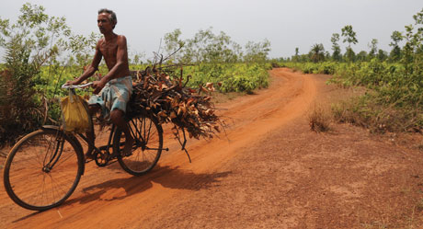
Is Joint Forest Management(JFM) relevant?
JFM
The Forest Rights Act 2006 (Scheduled Tribes and Other Traditional Forest Dwellers (Recognition of Forest Rights) Act)

Slide 14
Peoples perception Now a days
Government funding also depends upon your perception.
Government has to make policy to satisfy them
Source-Mr Rakesh Sharma(IFS),IIT Delhi Registrar

Slide 15
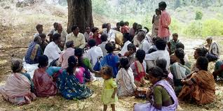
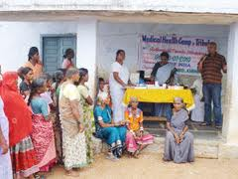
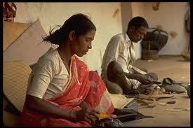
ROLE OF NGOs

Slide 16
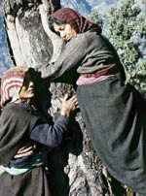
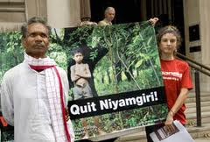
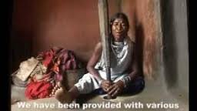
ROLE OF MEDIA

Slide 17
Role of Civil Society
Collaborate with the Environmental Movements in India and around the world since Man and Nature are intrinsically related and Tribes understand its true essence.
Creation of Social Capital through Community well-being and participation.
Effective implementation of Schedule V and VI provisions in creation of self governing bodies for tribal and hill region residents.
Promotion of sports like Hockey and Archery (with huge government support) where the true genius of the Tribals lie.
Bring in a debate in policy circles about Development-Displacement, Growth-Happiness, Profits-Sustainability.

Slide 18
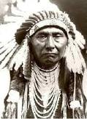
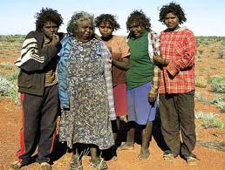
TRIBAL POLICY: INDIA AND WORLD INTERNATIONAL PERSPECTIVE
In Australia, after years of conflict of the whites with the Aborigines, the constitution has provided for fundamental right of Aborigines to retain their racial identity and traditional lifestyle. Self-Determination through Bottom-Up Policy formulation is top priority.
Aboriginal Land Rights (Northern Territory) Act 1976, along with Aboriginal Development Commission was established in 1980.
NGOs dealing with include land councils, incorporated community support groups, child care agencies, alcohol rehabilitation services, medical services, hostels, legal services and cultural organisations are increasingly getting more importance.
In USA, the policy parameters tended towards Isolation and Segregation.
Its only as recent as 1960s when full scale citizenship rights accorded to the Native Red Indians with slew of land allotment rights, provision of modern education, affirmative action in government services etc.

Slide 19
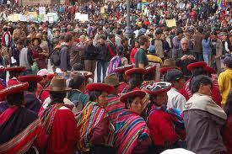
TRIBAL POLICY: INDIA AND WORLD INTERNATIONAL PERSPECTIVE
Under UN auspices, the Indigenous and Tribal Populations Convention 1989 envisage to:
Define tribes and indigenous people.
Makes governments responsible for developing, with the participation of the peoples concerned, co-ordinated and systematic action to protect the rights of these peoples and to guarantee respect for their integrity.
Indigenous and tribal peoples shall enjoy the full measure of human rights and fundamental freedoms without hindrance or discrimination. The provisions of the Convention shall be applied without discrimination to male and female members of these peoples.
Governments should ensure the effective protection with regard to recruitment and conditions of employment of workers belonging to these peoples, to the extent that they are not effectively protected by laws applicable to workers in general.

Slide 20
Analysis: Shift in Policy Approach
Alienation
Assimilation
Holistic
Adversary
Segmented
Partner

Slide 21
Policy Gaps:
‘One cap fit all’ policy
Security, Law & Order
Policy Formulation: Top- Down
Policy implementation: Lateral Horizontal
Financial and resource feasibility not clarified in the policy
No specification of Monitoring and Evaluation Process
No Timeframe for Policy implementation

Slide 22
Suggestions….
HDI Mapping of Tribal Areas
Development rating
Focused approach
National Policy as a broad framework
Region & community specific need based scheme
Involvement of Local government and community
Commercial Promotion of Tribal art and Skills
Enterprise
Marketing
Profit generation and distribution
Time bound Implementation
Rehabilitation Policy and other policies
National Tribal Finance Commission
Allocation on the basis of backwardness Index

Slide 23
Thank You

